Slide 1

Which of the following is the best approach for a patient with TNBC who suffers recurrent, metastatic breast cancer 8 months after completion of adjuvant chemotherapy with an anthracycline + cyclophosphamide + taxane?
Platinum-containing combination chemotherapy
Bevacizumab-containing combination therapy
Clinical trial with other agents targeting VEGF/VEGFR, EGFR, mTOR, PARP

Slide 2
Which of the following is the best approach for a patient with TNBC who suffers recurrent, metastatic breast cancer 8 months after completion of adjuvant chemotherapy with an anthracycline + cyclophosphamide + taxane?
Platinum-containing combination chemotherapy
Bevacizumab-containing combination therapy
Clinical trial with other agents targeting VEGF/VEGFR, EGFR, mTOR, PARP
28.1%
34.4%
37.5%

Slide 3

Optimizing Outcomes in Metastatic Triple-Negative Breast Cancer (TNBC): The Search for Targets
David Miles, MD, FRCP
Mount Vernon Cancer Centre
United Kingdom

Slide 4

Optimizing Outcomes in Metastatic Triple-Negative Breast Cancer (TNBC): The Search for Targets
David Miles, MD, FRCP
Mount Vernon Cancer Centre
United Kingdom

Slide 5
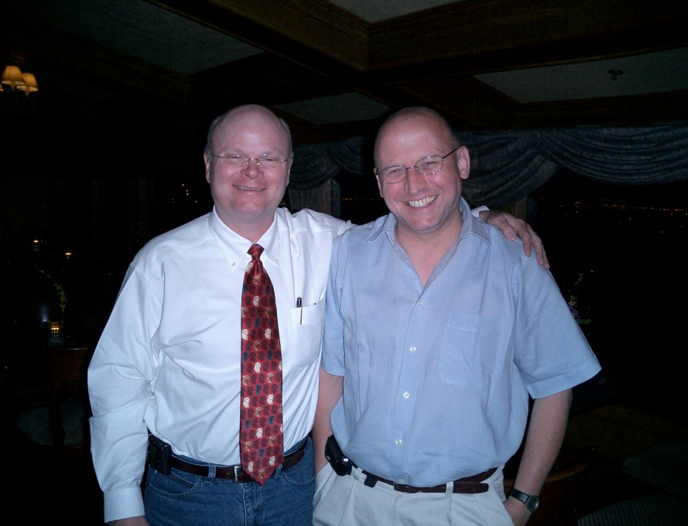
Optimizing Outcomes in Metastatic Triple-Negative Breast Cancer (TNBC): The Search for Targets
I am not Dr Pegram
David Miles, MD, FRCP
Mount Vernon Cancer Centre
United Kingdom

Slide 6

Optimizing Outcomes in Metastatic Triple-Negative Breast Cancer (TNBC): The Search for Targets
I am not Dr Pegram
David Miles, MD, FRCP
Mount Vernon Cancer Centre
United Kingdom
and I am not Dr Tutt

Slide 7
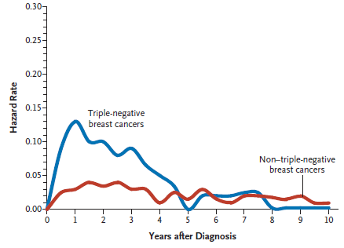
Triple-Negative Breast Cancer:
Hazard Rates for Distant Recurrence
Median time to distant recurrence
TNBC = 2.6 years
Other breast cancer = 5 years
P < 0.0001
Dent R, et al. Clin Cancer Res. 2007;13(15 Pt 1):4429-4434.

Slide 8
Chemotherapy in TNBC
Reference | Regimen | n | Prior treatment | Response rate (RR) | PFS | OS
046/048 (2008) | Capecitabine (Cap) + Ixabepilone | 230 213 | A + T A + T | 15% 31% | 1.7 m 4.2 m | 9 m 10.3 m
Solti-0701 | Cap 1g/m2 bd | 33 | 0-1 | NR | 2.5 m | 16.1 m
AC01B07 | Gemcitabine (Gem) 1g/m2 OR Cap 1g/m2 bd | 27 | 0-1 | NR | 2.6 m | NR
EGF30001 (2009) | Paclitaxel (Pac) 175 | 60 | 0 | NR | 4.8 m | NR
E2100 | Pac 90mg/m², D1, 8, 15 | 110 | 0 | NR | 5.3 m | NR
AVADO | Docetaxel 100/m², D1 | 52 | 0 | NR | 5.4 m | NR
Ribbon-1 | Taxane or anthracycline | 50 | 0 | NR | 4.2 m | NR
m, months

Slide 9
Platinum-Containing Regimens in TNBC
Reference | Regimen | n | Prior treatment | RR | PFS/DFS | OS
Sirohi, et al | Mitomycin C, vinblastine cisplatin (Cis) | 34 | 0-5 | 41% | 6 m | 11 m
Bhattacharyya, et al | CtxMtx (metronomic) Cis | 66 | 1 | 62% | 13 m | 16 m
Isakoff, et al | Carboplatin (Carbo) or cis | 86 | 0-1 | 30% | 3.2 m | NR
 |  | BRCA1/2+ve 55%: BRCA1/2-ve26%
Staudacher, et al | Cis + ifosfamide | 93 | 0-2 (A+T) | 33% | 6 m | 22 m
 |  | BRCA1/2+ve 5/11 responses
O’Shaughnessy, et al | Gem 1 g/m² D1,8, Carbo AUC2, d1,8 q3w | 62 | 0-3 | 32% | 3.6 m | 7.7 m
O’Shaughnessy, et al | Gem 1 g/m² D1,8, Carbo AUC2, D1,8 q3w | 258 | 0-2 | 30% | 4.1 m | 11.1 m
Baselga, et al | Cis 75 mg/m2 D1 q3w | 58 | 0-1 | 10% | 1.5 m | 9.4 m
Sirohi B, et al. Ann Oncol. 2008;19(11):1847-1852. Bhattacharyya G, et al. Eur J Cancer Suppl. 2009;7(2): Abstract 41LBA. Isakoff S, et al.
J Clin Oncol. 2011;29(15S): Abstract 1025. Staudacher L, et al. Ann Oncol. 2011;22(4):848-856. O’Shaughnessy J, et al. N Engl J Med. 2011;364(3):205-214. O’Shaughnessy J, et al. J Clin Oncol. 2011;29(suppl): Abstract 1007. Baselga J, et al. J Clin Oncol. 2013;31(20):2586-2592.

Slide 10
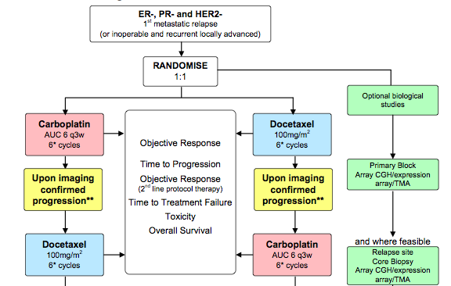
Carboplatin vs Docetaxel
Triple-Negative Trial (TNT)
PI Andrew Tutt
Notes:
Taxane-free interval of >12 months, so our patient here today would not be eligible

Slide 11
tnAcity: Study Design
Phase II
Phase III
US chair: Denise Yardley
EU co-chair: Nadia Harbeck
Nab-paclitaxel
125 mg/m² + carboplatin AUC 2 QW 2/3
(n = 80)
Winner of the 2 phase II nab-paclitaxel arms
(n = 275)
First-line TNMBC
R
Nab-paclitaxel
125 mg/m² + gemcitabine
1000 mg/m² QW 2/3 (n = 80)
Carboplatin AUC2 + gemcitabine
1000 mg/m² QW 2/3 (n = 275)
R
1:1
1:1:1
Carboplatin AUC2 + gemcitabine
1000 mg/m² QW 2/3 (n = 80)
Patients in phase II will not be included in phase III analysis
Continue treatment until PD or unacceptable toxicity
Phase II study start: June 2013
Phase II estimated completion (primary analysis): June 2015
Phase III ‘go/no go’ decision : Sep 2015
Notes:
Amendment earlier this year to exclude patients receiving taxane less than 12 months before trial entry i.e., the patient we are discussing would not be eligible

Slide 12
What About Bevacizumab?
 | Non-bevacizumab (n = 1,008) | Bevacizumab (n = 1,439)
1.0
0.8
0.6
0.4
0.2
0
Median, months | 26.4 | 26.7
HR (95% CI) | 0.97 (0.86–1.08)
 | P = .56
1-year OS rate, % | 77 | 82
 | P = .003
OS Estimate
0 6 12 18 24 30 36 42 48
Time, months
Number at risk:
Non-bevacizumab 1008 892 746 621 426 178 51 19 8
Bevacizumab 1439 1333 1127 916 591 204 55 23 5
Miles DW, et al. Ann Oncol. 2013;24(11):2773-2780.

Slide 13
First-Line Bevacizumab (E2100, AVADO, Ribbon-1, n = 2447): Subset Analyses
 | PFS HR (95% CI) | Median PFS, months |  | Median OS, months |  | 1-year OS diff | OS HR
 |  | BEV | Non-BEV
 |  |  |  | BEV | Non-BEV
TNBC (n = 621) | 0.63 (0.52-0.76) | 8.1 | 5.4 | 18.9 | 17.5 | 6.1% (1.5-13.6) | 0.96 (0.79-1.16)
Prior (neo) adjuvant taxane (n = 558) | 0.54 (0.44-0.67) | 9.2 | 6.0 | 26.7 | 20.5 | 7.3% (3.0-11.6) | 0.72 (0.57-0.90)
TNBC and prior taxane | NR | NR | NR | 25.6 | 15.0 | 16% | 0.61 (0.40-0.94)
Miles DW, et al. Ann Oncol. 2013;24(11):2773-2780.

Slide 14
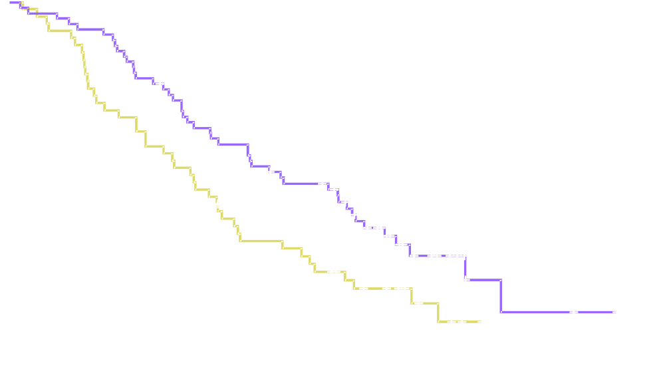
First-Line Chemotherapy ± Bevacizumab
Overall Survival (TNBC, Taxane Pretreated)
1.0
0.8
0.6
0.4
0.2
0
 | Treatment | Median, months
 | Bevacizumab combined with taxane (n = 69) | 25.6
 | Taxane alone (n = 52) | 15.0
Unstratified hazard ratio (95% CI) | 0.61 (0.40–0.94) P = .0247
Estimated Probability
0 3 6 9 12 15 18 21 24 27 30 33 36 39 42 45 48 51
Time, months
Miles D, et al. Ann Oncol. 2010;21(Suppl 8): Abstract 279PD.
Notes:
Mention Meridien study (biomarkers)
On the basis of this analysis, we have funding for bevacizumab for this group of patients in the UK

Slide 15
Efficacy Data From First-Line Studies With Bevacizumab in TNBC
Trial | ORR | PFS, months | HR –PFS/ 95%CI | OS
TURANDOT (n = 130)
Paclitaxel + BEV | 49% | 9.0 | 1.37 (0.93-2.0) | 78 (1 year)
Capecitabine + BEV | 19% | 5.6 |  | 63 (1 year)
ATHENA (n = 585) | 49% | 7.2 | (6.6-7.8) months | 18.3 months (16.4-19.7)
CALGB 40502 (n = 218)
Nab-paclitaxel + BEV |  | ≈ 7 | 0.93 (P = .74) | NR
Paclitaxel + BEV |  | ≈ 7 |  | NR
Ixabepilone + BEV |  | ≈ 5 | 1.46 (P = .06) | NR
AVAREG (n = 106)
Paclitaxel + BEV |  | 8.3 | (7.8-8.8) months | NR
Brodowicz T, et al. Cancer Res. 2013;73(24 Suppl): Abstract P6-06-40. Thomssen C, et al. Oncology. 2012;82(4):218-27. Rugo H, et al. J Clin Oncol. 2012;30(15S): Abstract CRA1002. Dank M, et al. Anticancer Res. 2014;34(3):1275-1280.
Some of these agents may not be currently approved by the US Food and Drug Administration or European Medicines Agency for this indication.

Slide 16
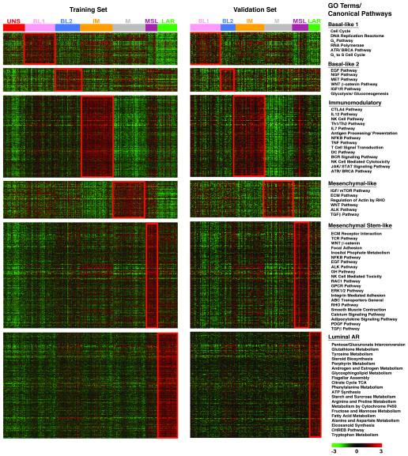
Identification of Human TNBC Subtypes
Basal-like 1: Cell cycle,
DNA repair and
proliferation genes
Basal-like 2: Growth factor
signaling (EGFR, MET, Wnt,
IGF1R)
IM: Immune cell
processes (medullary
breast cancer)
M: Cell motility and differentiation, EMT
processes
MSL: Similar to M but
growth factor signaling, low
levels of proliferation genes
(metaplastic cancers)
LAR: Androgen receptor
and downstream genes,
luminal features
Lehmann BD, et al. J Clin Invest. 2011;121(7):2750-2767.

Slide 17
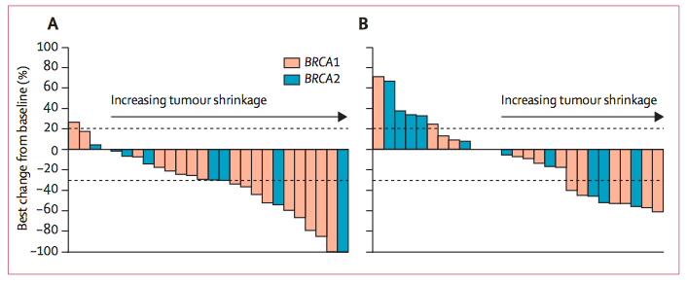
Olaparib in MBC: Patients With BRCA1/2 Mutations
Efficacy | Olaparib 400 mg bid (n = 27) | Olaparib 100 mg bid (n = 27)
ORR | 11 (41%)* | 6 (22%)
CR | 1 (4%) | 0
PR | 10 (37%) | 6 (22%)
PFS | 5.7 months | 3.8 months
Tutt A, et al. Lancet. 2010;376(9737):235-244
This agent may not be currently approved by the US Food and Drug Administration or European Medicines Agency for this indication.

Slide 18
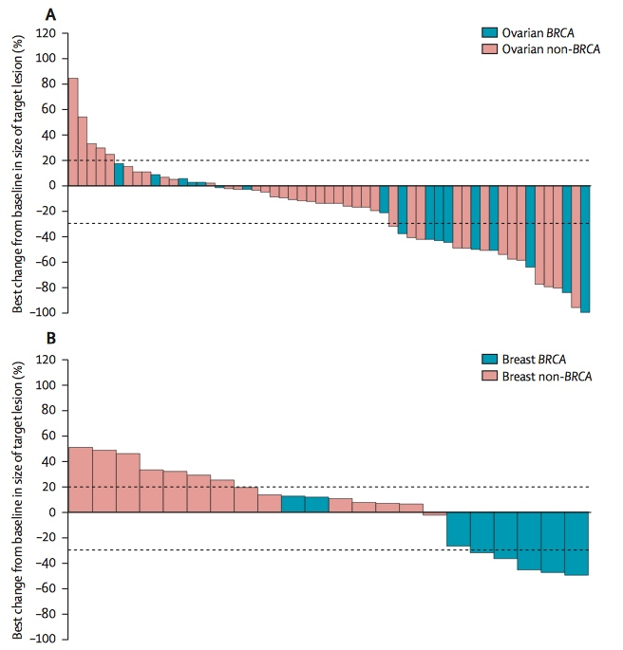
Olaparib in Ovarian and TNBC
 | Status | Responses
Ovarian cancer | BRCA1/2 | 7/17 | 41%
Ovarian cancer | Non-BRCA | 11/46 | 24%
Breast cancer | BRCA1/2 | 0/8 | 0
Breast cancer | Non-BRCA | 0/15 | 0
Gelmon KA, et al. Lancet Oncol. 2011;12(9):852-861.
This agent may not be currently approved by the US Food and Drug Administration or European Medicines Agency for this indication.
Notes:
In HGSOC responses tending to be seen in patients with platinum sensitive disease

Slide 19
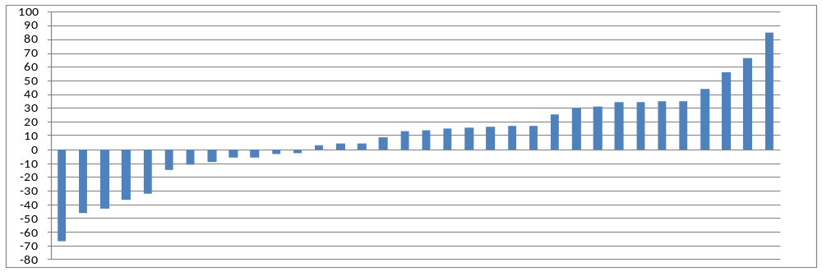
PARPi in Combination?
Phase II study
veliparib
(ABT-888) +
temozolomide
* = BRCA carriers
* * * * * *
Isakoff S, et al, J Clin Oncol. 2010;28(15S): Abstract 1019.
ORR 7% but 38% in BRCA1/2 carriers
Phase I study
olaparib +
paclitaxel
Paclitaxel 90 (D1,8,15) + olaparib | Cohort 1 n = 9 (no G-CSF) | Cohort 2 n = 10 (G-CSF)
CR | 0 | 0
PR | 3 | 3
Unconfirmed PR | 1 | 2
Dent R, et al. Breast Cancer Res. 2013;15(5):R88.
Phase I study
olaparib + cisplatin
“Olaparib in combination with cisplatin 75 mg/m(2)
was not considered tolerable”
Balmaña J, et al. Ann Oncol. 2014;25(8):1656-1663.
“Promising antitumor activity in patients with germline BRCA1/2 mutations was observed”
These agents may not be currently approved by the US Food and Drug Administration or European Medicines Agency for this indication.

Slide 20
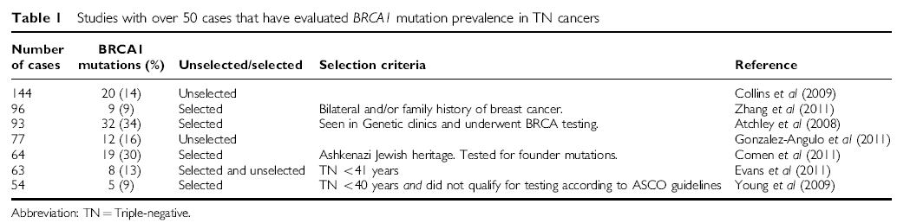
What Is the Prevalence of BRCA1 Mutation in Patients With TNBC?
Approximately 10%-30%
“For now, perhaps the simplest recommendation is to test
women under age 50 years with triple-negative breast cancer and women with a family history of early-onset breast cancer or ovarian cancer” Steven Narod JCO
Robertson L, et al. Br J Cancer. 2012;106(6):1234-1238.

Slide 21
Tesaro Trial in BRCA1 / BRCA2 Carriers With Advanced Breast Cancer
Niraparib
BRCA1 / BRCA2
carriers
Advanced taxane pretreated breast cancer
R
Treatment of physicians choice
Notes:
Could enter this patient into this study!

Slide 22
TNBC Subtypes: (Some) Research Strategies
Basal-like 1: Cell cycle,
DNA repair and
proliferation genes
PARPi, ± DNA damaging agents
homologous recombination
deficiency assay (BRCA-1 ness)
Basal-like 2: Growth factor
signaling (EGFR, MET, Wnt,
IGF1R)
EGFR (cetuximab, lapatinib)
Self-renewal pathways (stem cell)
Wnt
Notch (PF03084014, AACR 2012
IM: Immune cell
processes (medullary
breast cancer)
Immune check point
PD1/PDL1, CTLA4
Vaccines: MUC1, NYO-ESO1
M: Cell motility and differentiation, EMT
processes
Plus
PI3Ki, RAS/MEK/Erk, MET, PTEN
etc, etc
MSL: Similar to M but
growth factor signaling, low
levels of proliferation genes
(metaplastic cancers)
LAR: Androgen receptor
and downstream genes,
luminal features
Agents targeting androgen receptor (enzalutamide, bicalutamide, etc)
Notes:
Mention Homologous recombination deficiency assay
BAL4, PEGGY trial with PI3Ki
Mention exome sequencing of tumours etc

Slide 23
Conclusions: Treatment of TNBC
No standard therapy for metastatic TNBC
  No evidence that one chemotherapy is superior to another
  Are triple negative breast cancers truly more susceptible to platinum-based vs other chemotherapy (hence TNT)?
  Which sub-groups benefit most?
  Is there a difference between cisplatin and carboplatin?
Most active agents currently licensed for use appear to be:
  Cisplatin based chemotherapy
  Chemotherapy + bevacizumab
Find out BRCA1/2 status and put your patients into clinical trials
  Entry criteria MUST reflect the natural history of the disease

